Slide 1
XYZ Corp. - a consulting firm
Employee Attrition Analytics
Year: 2016-2018
Imarticus dsp15 Group 6
Indira, Anita, Giridharan, Nazmeen

Slide 2
XYZ Corp.
The objective of the report is to use staff utilization dataset for the period 2016-2018 and perform the following tasks:
Perform Exploratory Data Analysis
Build a data model for predicting attrition
Identify factors influencing attrition
Predict possible attritions
Identify possible ways to retain high performers
Identify factors that help in retaining employees

Slide 3
Staff Utilization Data Dictionary
Column Name | Description
Employee No | Unique idetifier for each employee
Office Location | Management-oriented organizational unit of the organization for the purpose of internal control
Employee Name | Name of Employee (Masked)
Employee Position | Employee designation within the organization
Employee Location | City in which employee is based out of
People Group | Employee type (client facing employee or support staff such as HR, payrolll, etc)
Employee Category | Refers to status of employee such as part-time employee, full time employee, awaiting termination
Supervisor name | Manager of the said employee
Join Date | Joining date of employye in XYZ Corp
Current Status | Current status of employee (Active, Resigned, etc)
Termination Date | Last working data, applicable for resigned employee
Total Hours | Total no. of chargeble hours avaibable during month (No. of working days in month X 8 hours per day)
Total Available Hours | Actual no of chageble hours available in the month for the employee (Total hours - Leave hours , if any)
Work Hours | Actual chargebale hourse during the month reported by employee
Leave Hours | Total leaves used by employee during a month
Training Hours | Total hours reported under Training by the employee
BD Hours | Total hours spent by employee under Business Development
NC Hours | Non chargeble hours reported by emplyee
Utilization% | Total utilization of the employee during month

Slide 4
Terminations Data Dictionary
Column Name | Description
Employee Number | Unique idetifier for each employee
Employee Name | Name of Employee (Masked)
Profit Centre | Management-oriented organizational unit of the organization for the purpose of internal control
Location | City in which employee is based out of
Sub Location | Employees Office Location in City
Job | Employee designation within the organization
Date First Hired | Joining date of employye in XYZ Corp
Termination Date | Last working data, applicable for resigned employee
Date of Birth | Birth date of employee
Gender | Gender of employee
Employee Category | Refers to status of employee such as part-time employee, full time employee, awaiting termination
People Group | Employee type (client facing employee or support staff such as HR, payrolll, etc)
Supervisor Name | Manager of the said employee
Tenure | Total no. of employee in the organization
Leaving Reason | Reason of employee termination
Assignment End Date | Last working day
Gratuity Date | Date from which gratuity is to be calculated
Previous Employer | Previous employer of the employee
Last Update Date | Last date on which the employee data was updated
Latest Available Rating | Employee performace rating (scale 1-5, 1 being highets and 5 being lowest)
Source of Hire Details | Source from which employee was hired (name of colleges, employee referrrel, job portals, etc)
Referrer Emp No | If employee was referred by another employee , this column would contain referees employee number

Slide 5
Problem Statement
Employee attrition refers to the loss of employees through several circumstances, such as resignation and retirement. The cause of attrition may be either voluntary or involuntary. Each industry has its own standards for acceptable attrition rates. Due to the expenses associated with training new employees, any type of employee attrition is typically seen to have a monetary cost. Attrition rate at any organization for a given month is calculated as the total number of employees leaving the firm divided by the total headcount for that month.
OBJECTIVE: Identify factors influencing attrition, Predict possible attritions, Identify possible ways to retain high performers

Slide 6
Understanding and Cleansing the data

Slide 7
Understanding data
For this Attrition analysis, XYZ corp staff utilization dataset is used for the years 2016-17 and 2017-18
Dataset1 – Contains 2016-17 staff utilization hours
(staff_utlz_latest_16_17_masked.xlsx)
Dataset2 – Contains 2017-18 staff utilization hours
(staff_utlz_latest_17_18_masked.xlsx)
Dataset3 – is prepared by combining both year data and then
  Delete monthly staff utilization hours since yearly utilization data is available.
  Using MySQL, combine Dataset1, Dataset2 to get 2016-2018 data
  Using MySQL, for employees who worked in both years add their work hours
  There were missing values for Month Year Termination date, so we have taken it as end of the year date(03/31/2018). This replacement is done to find out No of working years in the company.
Dataset 4 - Combine 2 year staff utilization data with terminations data for EDA

Slide 8
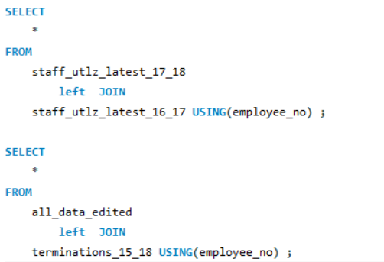
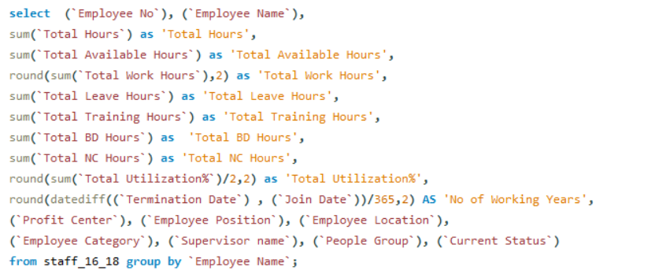
Combining data using MySQL

Slide 9
Exploratory Data Analysis
With Tableau

Slide 10
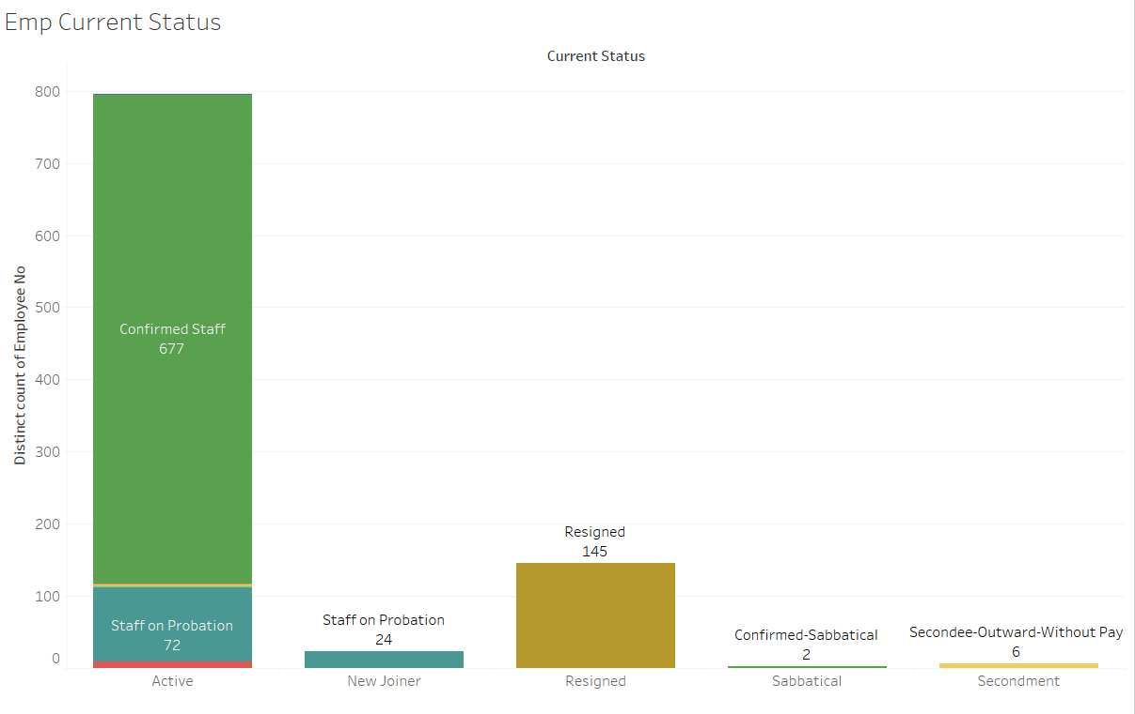

Slide 11
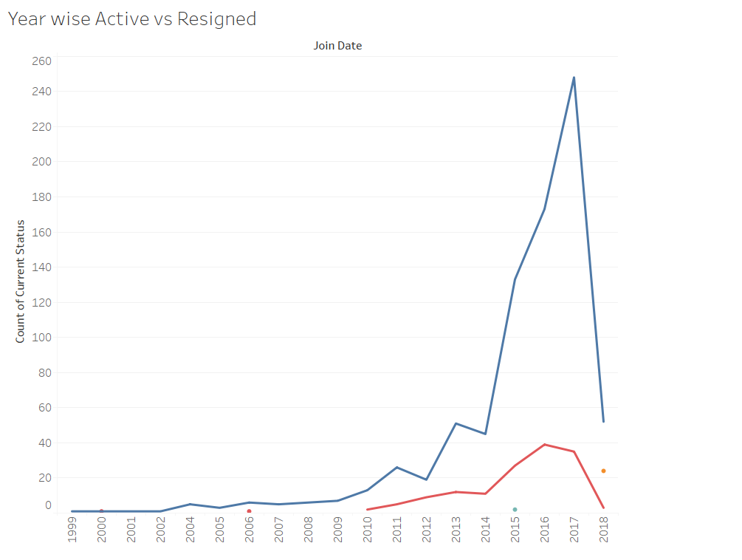
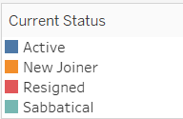

Slide 12
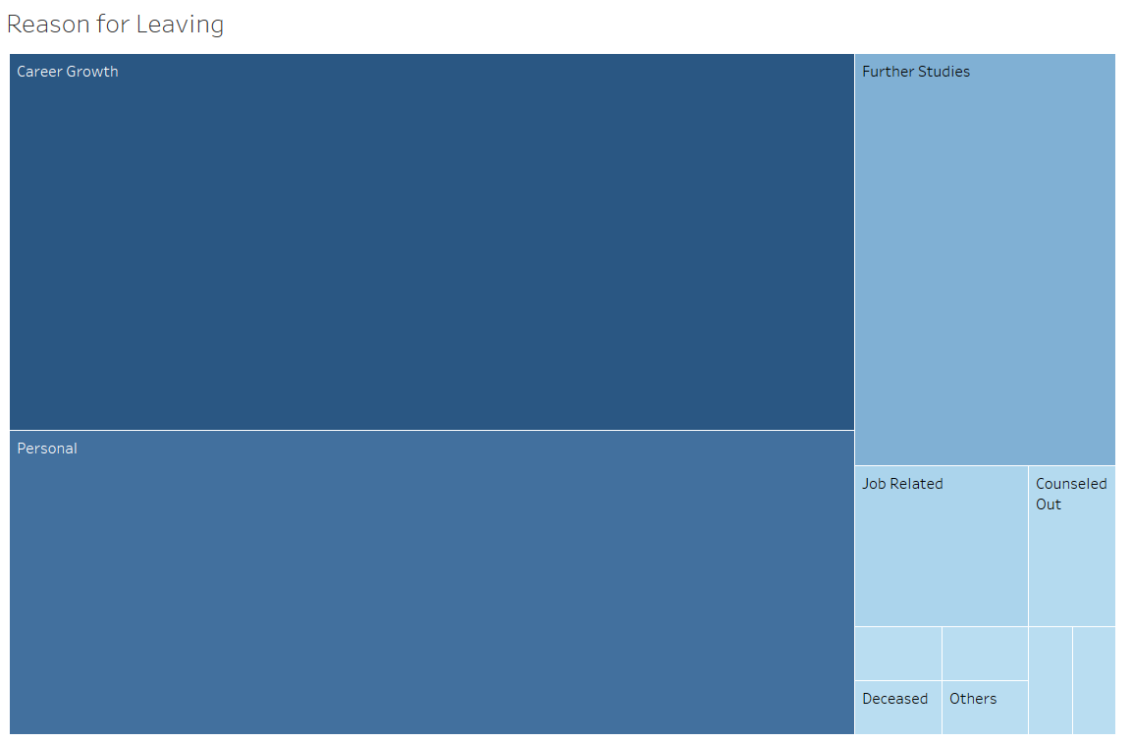
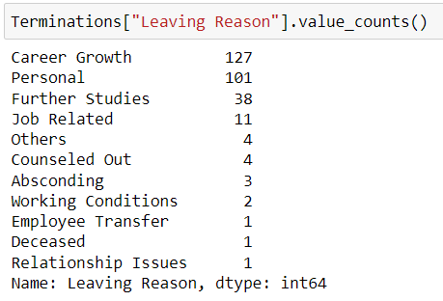

Slide 13
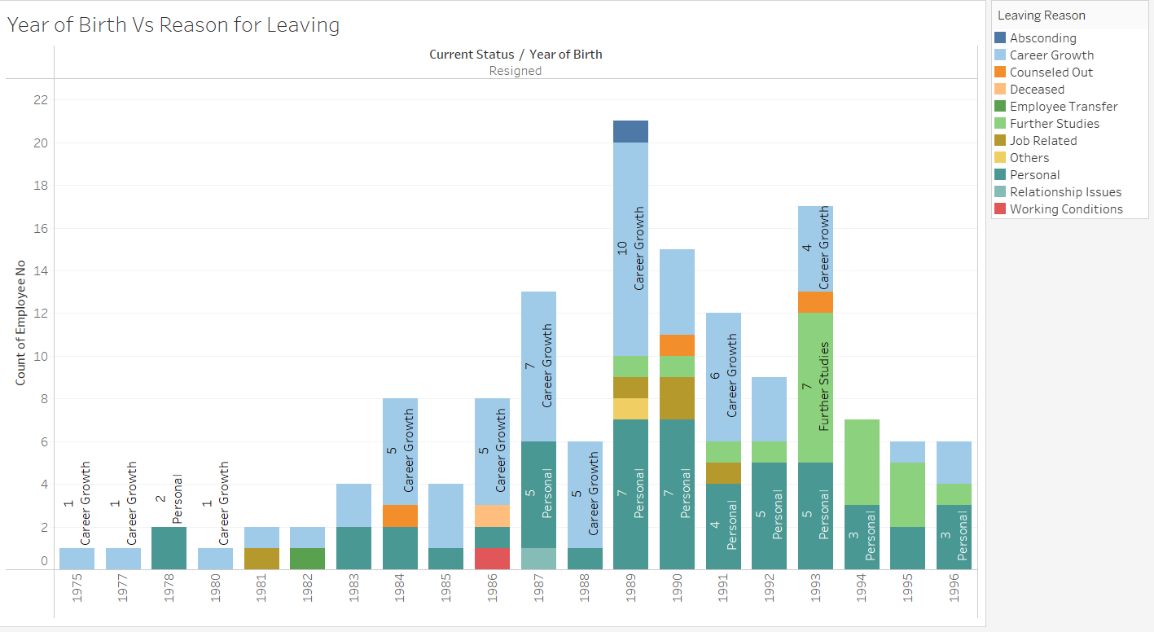

Slide 14
Exploratory Data Analysis with Python
Imported libraries and read excel to the program.
Exploratory data Analysis refers to the process of performing initial investigations on the data to discover patterns, spot inconsistencies, to test hypothesis and to check assumptions with the help of graphical representations.

Slide 15
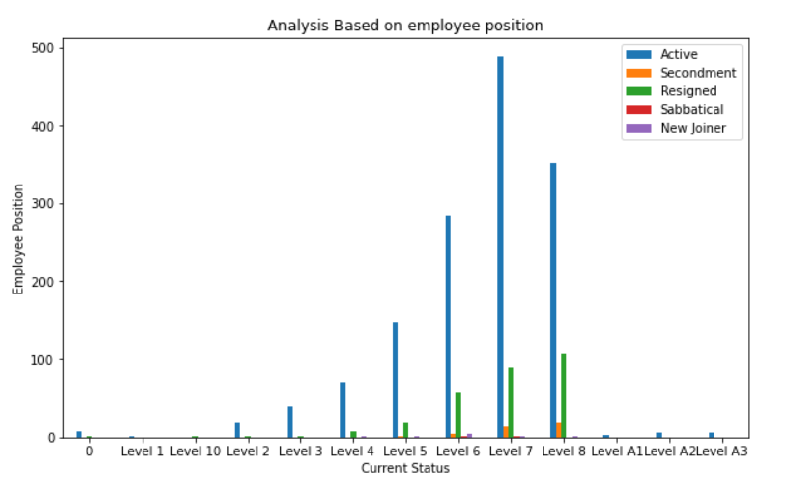
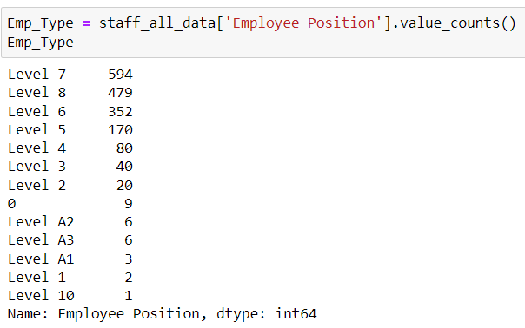
Employee Position vs. Employment status

Slide 16
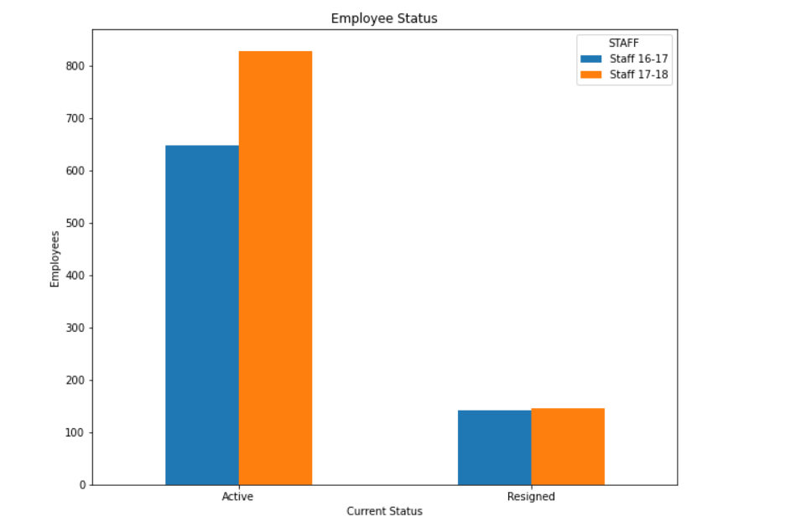
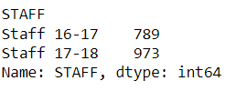
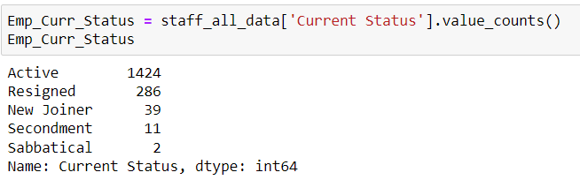
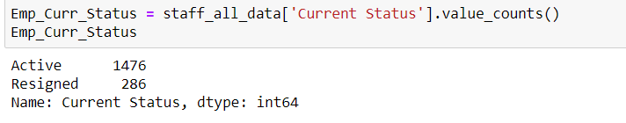
Employee Status
Active Vs Resigned
# Grouping current status and perform count over each year

Slide 17
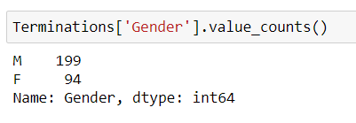
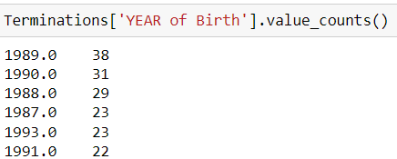
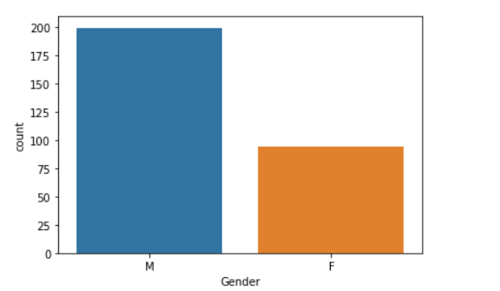
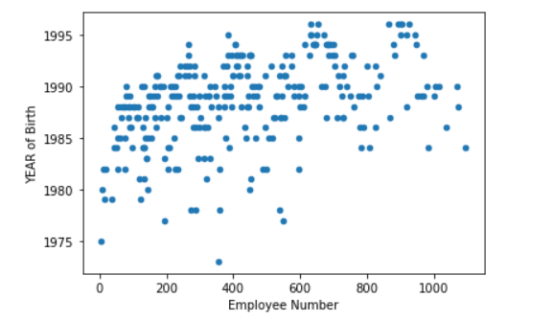
Resignation Analysis
Gender, Age

Slide 18
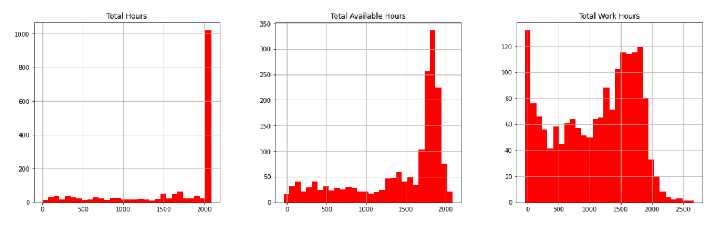
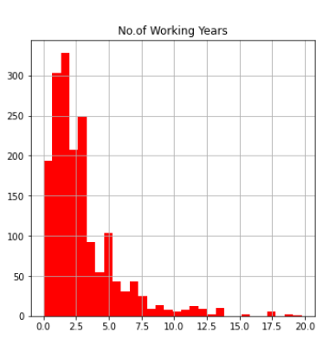
Staff Utilization

Slide 19
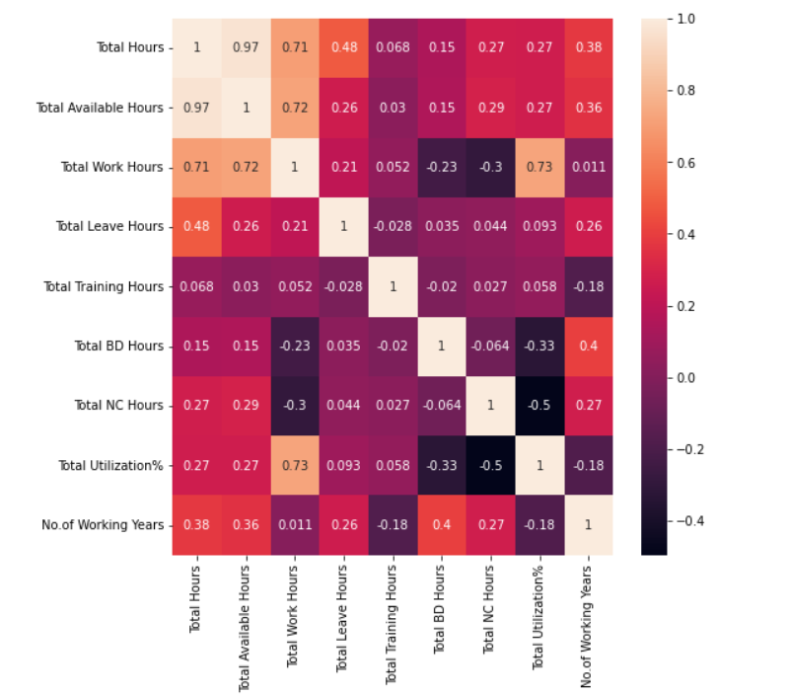
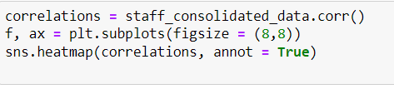
Correlation

Slide 20
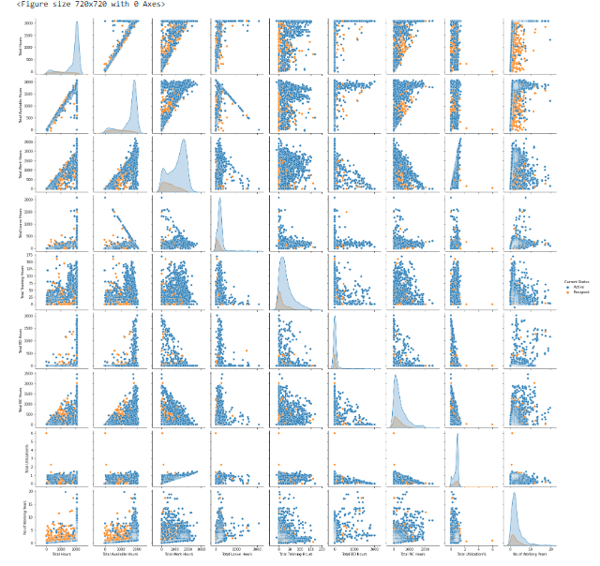

Pair Plot

Slide 21
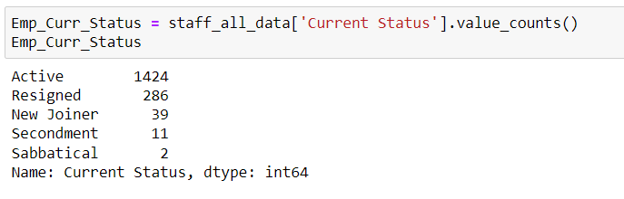
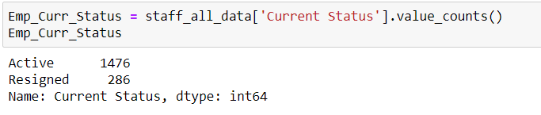
Data Cleaning and Preparation
#Emp Status: Replace some current status to convert to categorical variables such as 'Active' and 'Resigned‘
staff_all_data['Current Status']=staff_all_data['Current Status'].replace({'New Joiner':'Active','Secondment':'Active','Sabbatical':'Active'})

Slide 22
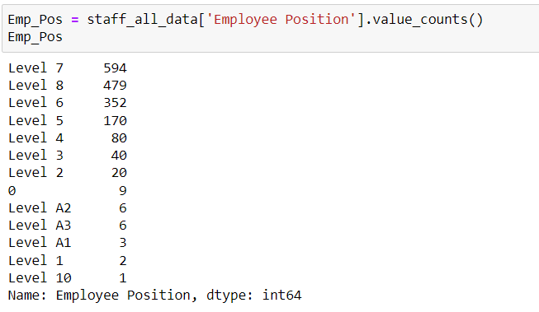
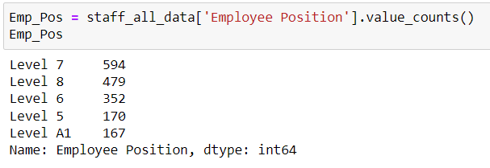
Data Cleaning and Preparation
#Emp Position: Replacing Leves A1,A2, A3, 1, 2, 3, 4 , 10 with A1
staff_all_data['Employee Position']=staff_all_data['Employee Position'].replace({'Level 1':'Level A1', 'Level 2':'Level A1', 'Level 3':'Level A1','Level 4':'Level A1', 'Level A2':'Level A1', 'Level A3':'Level A1', 0:'Level A1', 'Level 10':'Level A1'})

Slide 23
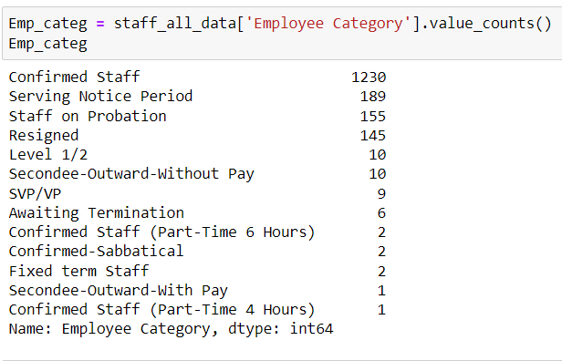
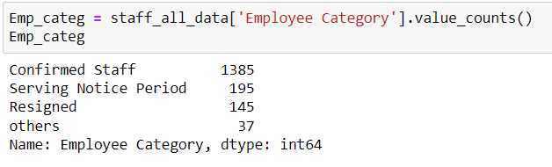
Data Cleaning and Preparation
#Emp Position: # Replacing Level 1/2, Secondee-Outward-Without Pay, SVP/VP,Confirmed Staff (Part-Time 6 Hours), Confirmed-Sabbatical, Fixed term Staff
# Secondee-Outward-With Pay, Secondee-Outward-With Pay with others
staff_all_data['Employee Category']=staff_all_data['Employee Category'].replace({'Level 1/2':'others', 'Secondee-Outward-Without Pay':'others', 'SVP/VP':'others','Confirmed Staff (Part-Time 6 Hours)':'others', 'Confirmed-Sabbatical':'others', 'Fixed term Staff':'others', 'Secondee-Outward-With Pay':'others', 'Confirmed Staff (Part-Time 4 Hours)':'others'})
staff_all_data['Employee Category']=staff_all_data['Employee Category'].replace({'Staff on Probation': 'Confirmed Staff'})
staff_all_data['Employee Category']=staff_all_data['Employee Category'].replace({'Awaiting Termination': 'Serving Notice Period'})

Slide 24
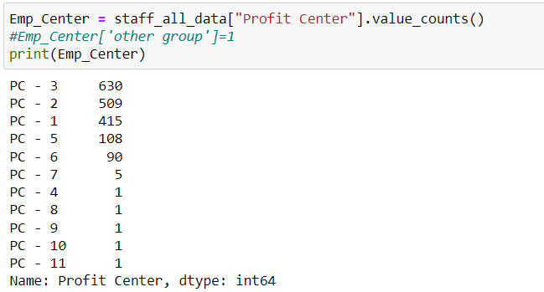
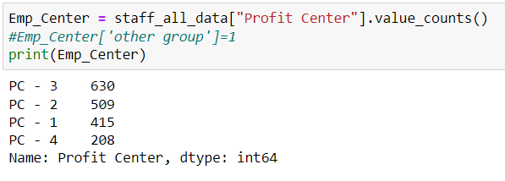
Data Cleaning and Preparation
# Emp Profit Centre Replace PC 4, 5, 6, 7, 8, 9, 10, 11 with PC - 4
staff_all_data['Profit Center']=staff_all_data['Profit Center'].replace({'PC - 5':'PC - 4','PC - 6':'PC - 4','PC - 7':'PC - 4', 'PC - 8':'PC - 4', 'PC - 9':'PC - 4', 'PC - 10':'PC - 4', 'PC - 11':'PC - 4'})

Slide 25
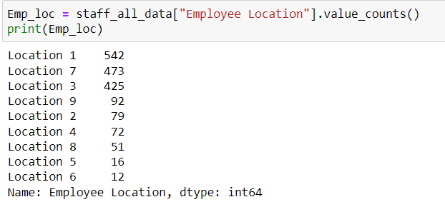
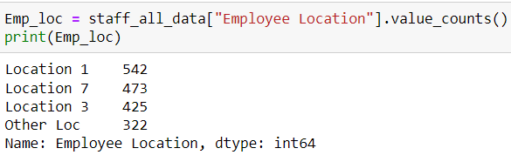
Data Cleaning and Preparation
# Replace Emp Location 2,4, 5, 6, 8, 9 with other Loc
staff_all_data['Employee Location']=staff_all_data['Employee Location'].replace({'Location 2':'Other Loc','Location 4':'Other Loc','Location 5':'Other Loc', 'Location 6':'Other Loc', 'Location 8':'Other Loc', 'Location 9':'Other Loc'})

Slide 26
Dropping columns before model building

Slide 27
Dropping columns
staff_all_data.drop(['Apr Utilization%','May Utilization%', 'Jun Utilization%', 'Jul Utilization%', 'Aug Utilization%', 'Sep Utilization%', 'Oct Utilization%', 'Nov Utilization%', 'Dec Utilization%', 'Jan Utilization%', 'Feb Utilization%', 'Mar Utilization%', 'Employee No', 'Employee Name'],axis=1, inplace=True)
staff_all_data.drop(['Supervisor name'],axis=1, inplace=True)
  Deriving the number of working years at a company based on Join date and Termination date.
staff_all_data['No.of Working Years']=staff_all_data['Termination Date']-staff_all_data['Join Date']
staff_all_data['No.of Working Years']=staff_all_data['No.of Working Years']/np.timedelta64(1,'Y')
staff_all_data.drop(['Join Date','Termination Date'], axis=1, inplace=True)

Slide 28
Modeling

Slide 29
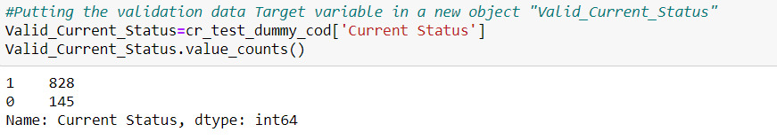
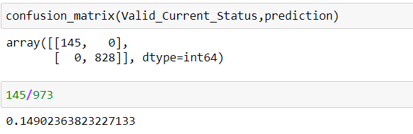
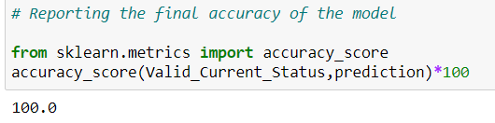
Logistic Regression

Slide 30
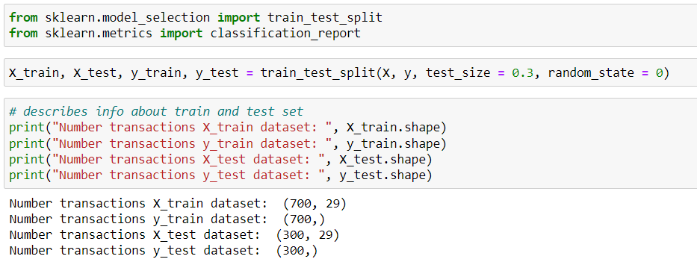
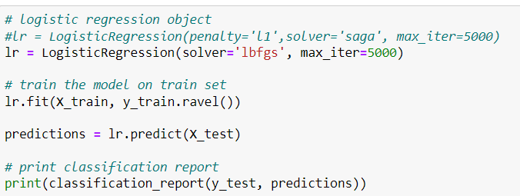
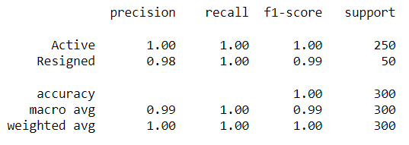
SMOTE – Logistic Regression

Slide 31
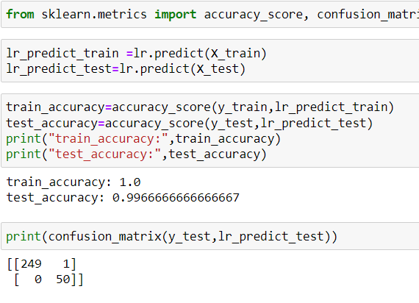
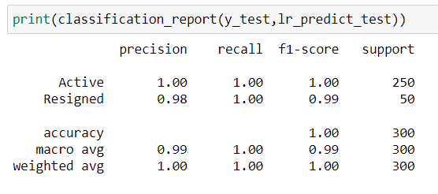
SMOTE – Confusion Matrix

Slide 32
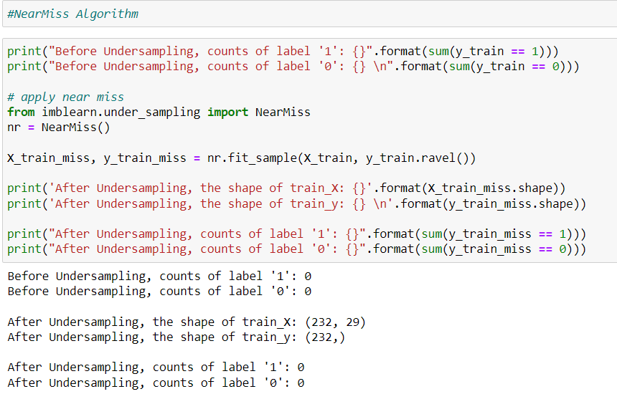
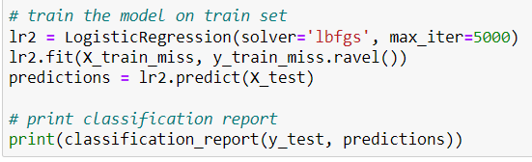
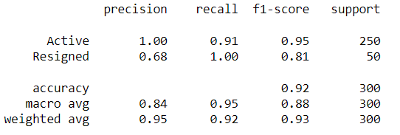
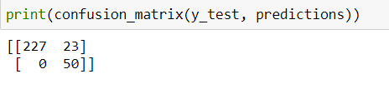
SMOTE – Near Miss Model

Slide 33
XGB Model
Analytics Approach
Checking for missing values in the data, and if any, will process the data accordingly.
Understand how the features are related with our target variable – attrition.
Convert Categorical into numeric form.
Apply feature selection and feature engineering to make model ready.
Apply XGBoost Model .
Draw our recommendations based on the analysis

Slide 34
XGB - Feature Engineering
Label Encoding:
Label encoding refers to converting the categorical variables into numeric form, so as to convert it into the machine-readable form.
Fit and transform the required columns of the data, and then replace the existing text data with the new encoded data.
For this process we have split the data of 2016-17 and 2017-18 to use it as train data (2016-17) and test data for 2017-18.

Slide 35
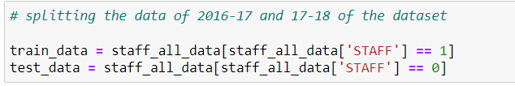
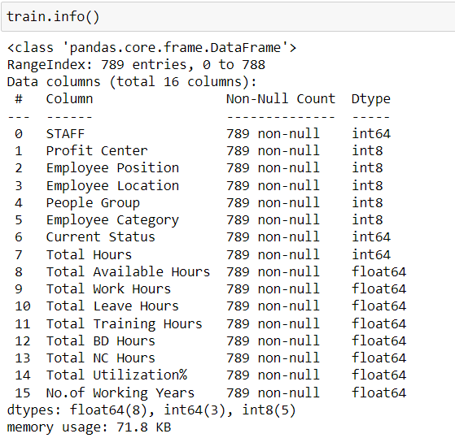
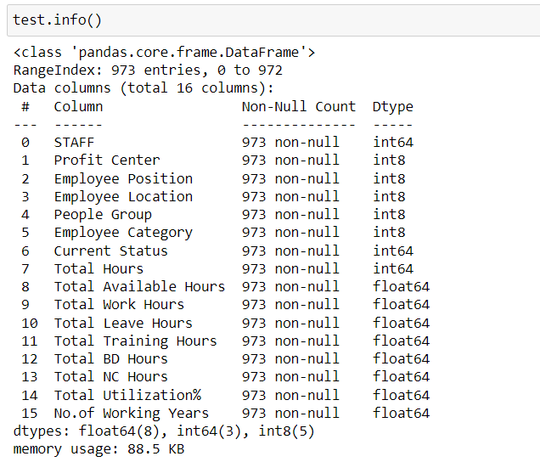
XGB

Slide 36
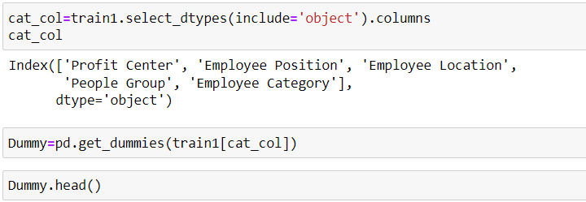
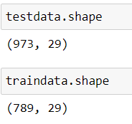

XGB
Converting categorical to Numerical for train data, Dummy encoding

Slide 37





XGB Model
Here, if we observe in the graph, the active employees density is higher than the resigned employees

Slide 38



XGB Model

Slide 39
Projected Attrition Percentage
Model | Matrix | Attrition Percentage
Logistic Regression | array([[145, 0], [ 0, 828]], dtype=int64) | (145/828)*100 = 17.51%
SMOTE | [[249 1] [ 0 50]] | (50/249)*100 = 20.08%
NearMiss Algorithm | [[227 23] [ 0 50]] | (50/227)*100 = 22.026%
XGB | array([[125, 5], [ 0, 28]], dtype=int64) | (28/125)*100 = 22.40%
XGB Probability |  | (178/795)*100 = 22.389%

Slide 40
Attrition Rate
Employee attrition refers to the loss of employees through several circumstances, such as resignation and retirement. Cause of attrition may be either voluntary or involuntary
Attrition rate at any organization for a given month is calculated as the total number of employees leaving the firm divided by the total headcount.
The model suggests that out of 973 employees, 214 employees may resign.
In xyz corp the Attrition rate may be ~22%

Slide 41
Factors that would help in retaining employees
Increase Training Hours. Since 127 employees resigned for Career Growth.
Recruit balanced and diverse employees. Track Male , Female employee ratio. Female resignations are lower than male employees.
Provide training and growth opportunities for employees in positions in ‘Level 6,7,8’

Slide 42
Factors that would help in retaining high performers
Increase Training Hours.
Decrease NC (Non Chargeable) Hours
Increase BD (Business Development) Hours
Provide required leave options to help improve work life balance

Slide 43
Recommendation and Conclusion:
Majority of the Employees who are leaving the company are between 0-4 years of experience.
Training Hours can be increased to retain employees (either by having knowledge gap sessions, quizzes, and other actives) can be implemented to retain employees
Benefits:
  Improves Quality of Work
  Reduces Stress
  Improves the productivity of the employee
  Reduce the attrition possibilities

Slide 44
Thank You

